Slide 1
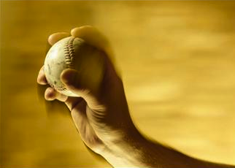
Developing Your Perfect Pitch

Slide 2
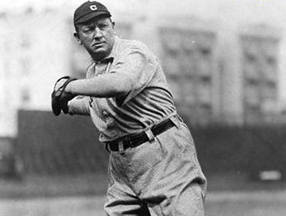
Notes:
Let’s start our discussion with a question. Does anybody know the identity of this gentleman? Cy Young – the first pitcher in the American League to pitch a perfect game in 1904 and the namesake of the annual award given to the best pitchers in baseball. So what does this have to do with developing your perfect pitch?
http://www.baseball-almanac.com/pitching/piperf.shtml
http://sportsweeksportslist.files.wordpress.com/2011/07/cy-young.jpg

Slide 3
How to Pitch a Brilliant Idea
Kimberly Elsbach
September 2003
Notes:
This perfect pitch analogy was inspired by the award-winning academic research of Kimberly Elsbach who spent six years studying the art and science of the pitch process Hollywood, where screenwriters pitch film concepts to producers. The central finding of the research, which was published in the Academy of Management Journal and the Harvard Business Review, revealed that the success of a pitch depends as much on the person receiving the pitch (i.e., the catcher in the baseball analogy) as on the pitcher.

Slide 4
Notes:
So if the catcher (who was the producer in Elsbach’s research) categorized the pitcher (who was the screenwriter) as “uncreative” and “ineffective” in the first few minutes, the meeting was essentially over. The researchers learned that the secret to success in this case was that the pitcher had to study and understand the signals the catcher was giving them to throw the perfect pitch.
The lesson of this story that I emphasize to my students, is that it is not all about the pitcher … it is not all about them. I think too often we do a disservice to our students when we tell students things like their resumes should be all about them and their accomplishments, when actually their resumes should be written from the perspective of the employer and what students are able to contribute to the success of their organizations.

Slide 5
Notes:
So if the catcher (who was the producer in Elsbach’s research) categorized the pitcher (who was the screenwriter) as “uncreative” and “ineffective” in the first few minutes, the meeting was essentially over. The researchers learned that the secret to success in this case was that the pitcher had to study and understand the signals the catcher was giving them to throw the perfect pitch.
The lesson of this story that I emphasize to my students, is that it is not all about the pitcher … it is not all about them. I think too often we do a disservice to our students when we tell students things like their resumes should be all about them and their accomplishments, when actually their resumes should be written from the perspective of the employer and what students are able to contribute to the success of their organizations.

Slide 6
What is a “brand” and why does it matter?
A brand represents all of the words and images people think about when they hear your name.
So the value of a professional brand matters …
When you are seeking to network to find internships or your first job after college
When you are seeking to grow your influence or advance within your current organization
When you are seeking to change careers or re-enter the workforce after a major life change

Slide 7
What is Your Brand Promise ?
What should customers (employers) expect from your products and services
“I teach people how to pursue and promote their passions.”
“Changing the world
through innovation.”
- Steve Jobs or Elon Musk
Notes:
The first step in this process is to encourage students to think about their brand promise. I like to think that my personal brand promise is “I teach people how to pursue and promote their passions.”
The following resource shares additional examples: http://www.billmarshjr.com/a-brand-is-a-promise-3-great-examples-of-strong-brands-that-make-strong-promises/

Slide 8
Brand Exercise
Select a brand that represents you and explain why.

Slide 9
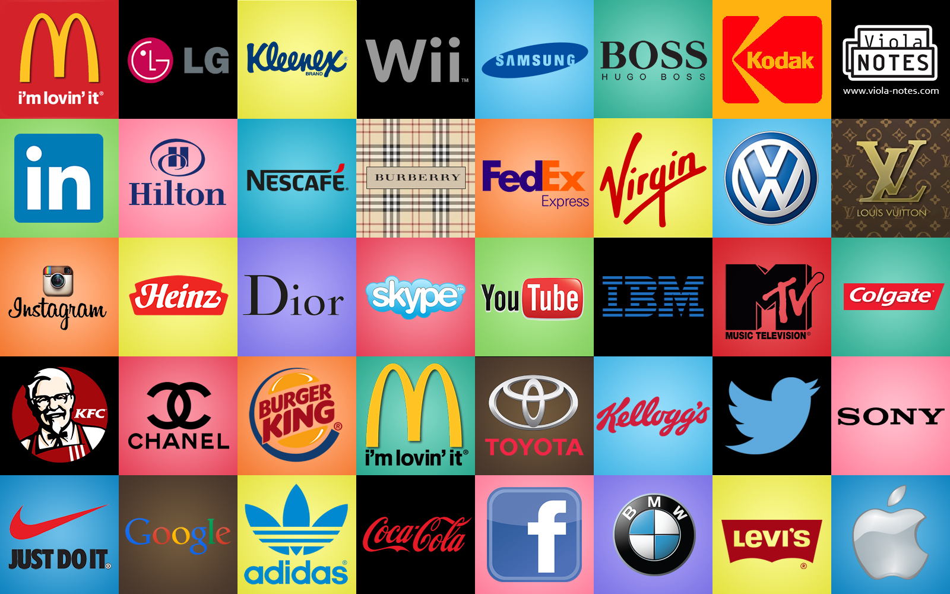
Brands as Story Tellers
Notes:
Image source: https://cognitives.io/blog/2016/09/01/5-examples-brands-winning-content-marketing-2016/

Slide 10
How to Master Your Own
Professional Brand
Crafting your “elevator pitch” (3:10)
Notes:
Student Rap: https://www.youtube.com/watch?v=gHjQ0AVpURg

Slide 11
Brand Points
Specific characteristics that reflect your personal brand promise
Leadership experiences
Academic achievements
Professional contributions
Notes:
Students need to keep in mind the needs of the catcher/employer and develop brand points from their perspective. Brand points are not a list of titles or credentials, but rather a few specific concrete examples that allow employers to understand what value a student could contribute to their organization.

Slide 12
Perfect Pitch Video Examples
Include an end slate with personalized LinkedIn URL
YouTube Text – This video was prepared for a marketing course taught by Prof. Dawn Edmiston at the Raymond A. Mason School of Business, College of William & Mary.
Notes:
Sample perfect pitch videos can be watched on this playlist.

Slide 13
Assignment Specifics
Today Introduction of concept
Th 11.1 Visit Media Center
Next Week Video script preparation
Th 11.7 Media Center Workshop
11.19–21 No Formal Class Meetings -
Finalize Videos
Sun. 11.25 Video due on YouTube
Mon. 11.26 Showtime!
Notes:
.

Slide 14
Assessment
Structure of Pitch
introduction that generates interest
compelling brand points that emphasize your value to future employers
conclusion that creates final impact
Delivery of Pitch
effective use of voice and visuals
professional presence
:60 second requirement (not to exceed :66 )
accessible through YouTube / LinkedIn
Notes:
Since YouTube is considered the world’s second largest search engine (Elliott, 2013), the perfect pitch video also becomes a positive contribution to the student’s professional online presence. In addition, students are required to embed their videos on LinkedIn.

Slide 15
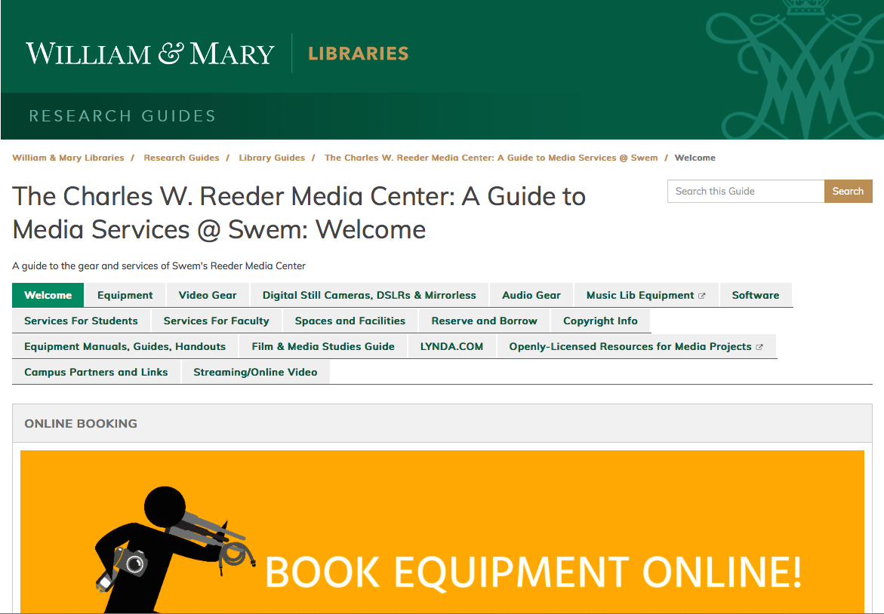
Video Introduction

